Slide 1

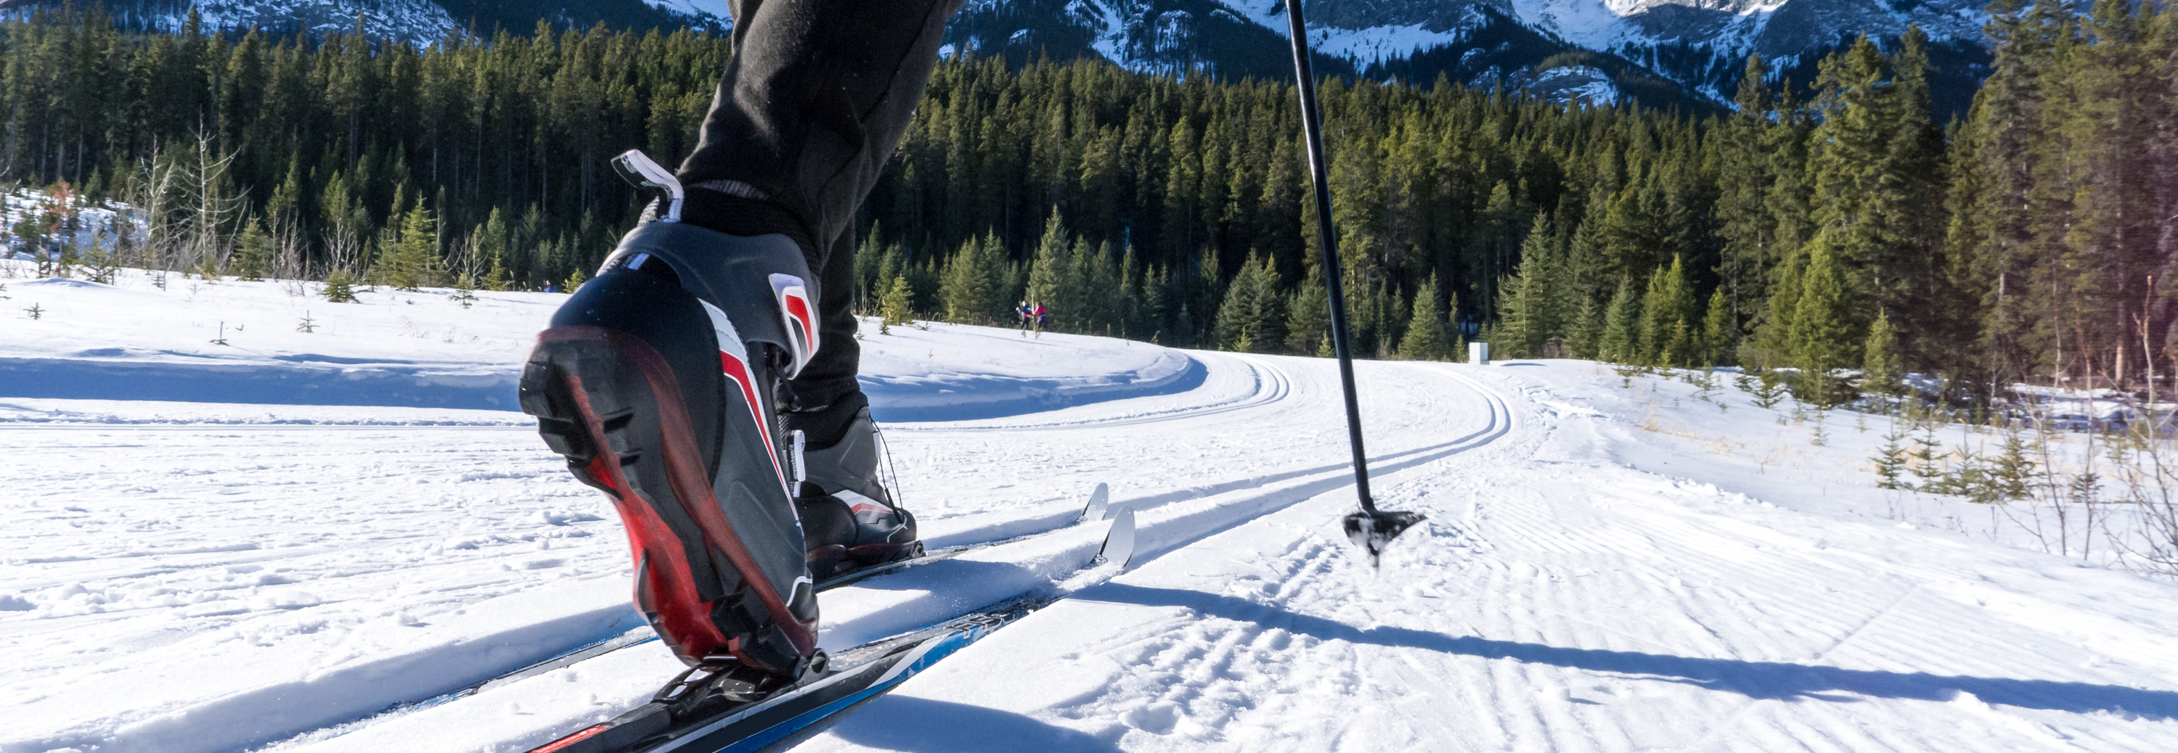

Ski Resort Pricing Model
Notes:
(Note: these notes are to share methodology and were not used for memorization or read during presentation, they are for tying story with a thread and baseline for practice sessions)
Hi ____ ! thank you for joining me and sharing your time!
This Project is for an outlet with wide range of products, mediums of sale like store, web and so on, and with a customer base across the globe.
.
Now prior to the last marketing campaign there were 5 other campaigns with various levels of success.
However, the Last campaign was the most successful one yet.

Slide 2
Problem Statement
How can we increase revenue generated next season by 20% to balance the increase in operating costs by:
a) Adjusting ticket prices
b) Identifying key facilities for further investment
Approach
Data Cleaning
Exploratory Data Analysis
Preprocessing
Modeling and Validation
Notes:
Our goal is to build on success of the last campaign and make sure that the future campaigns are as successful as they can be.
We want to maximize the number of acceptance by the customers or the acceptance rate by Identyfing key customers.
We started by cleaning the large amount of data we had, and then began exploring different factors and identified key factors with respect to the problem statement.
After that we built not one but two prediction models to help predict behavior of customers in future.
Let’s begin exploring!!

Slide 3
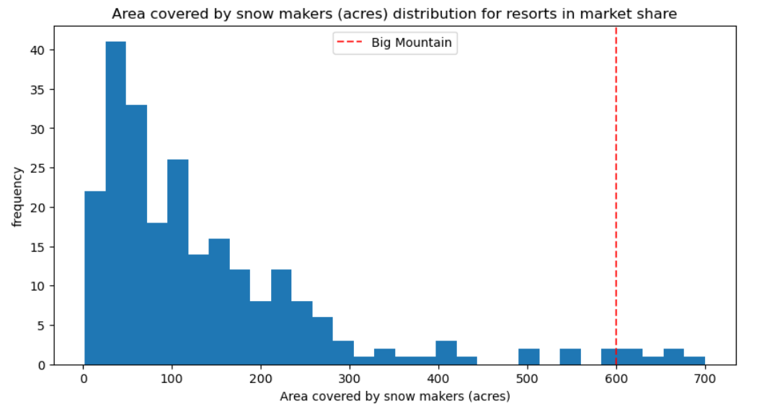
Recommendation and Key finding
Big Mountain Resort’s revised ticket prices of $95.87 support a revenue increase of 18%
Investment in both Scenarios 2 and 3 supplements this growth with $8.61 and $9.90 increase in price respectively
(Big Mountain offers customers services they care about like snow-making area equipment at a level much higher than market standard as shown above
This high standard of delivery across key factors is the main reason we can support an increase in ticket prices)
Notes:
So, after exploring the key factors we enter the world of prediction, this might feel a bit daunting at first, but it is simpler than it looks.
One simple way to look at it is the further up and away our model is from the red line which denotes flipping a coin, the better the model is.
We see that both our models do a significantly better job than the red line, which is always a good thing. I don’t want to be replaced by a coin flip ☺
We can also see that the model in orange is further away from red line, this model identifies nearly 99% of customers who will accept or not accept the campaign.
Now these performances are for the data used to build the model, since we don’t have data from future, we used 85% of data to build this model and rest to test it!
That’s where the real challenge and the drop comes in, so exciting stuff ahead! Are we ready to find out how we did on the test?

Slide 4
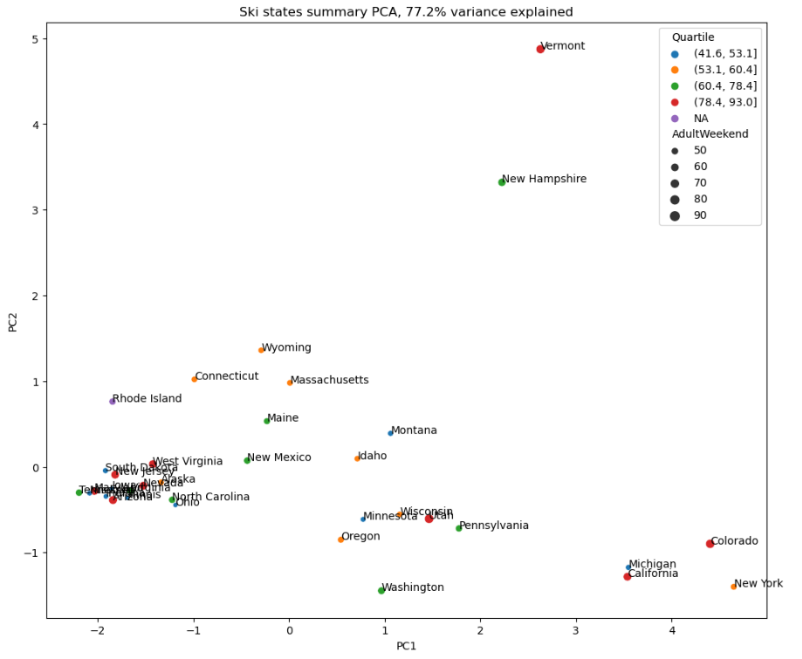
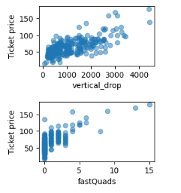
Modeling Results and Analysis
Changing the dimensionality of data and being able to visualize ticket prices as a component of available data and state, confirmed that ticket prices don’t have a pattern based on states
During these steps, the relation between certain factors and ticket prices jumped out, for e.g., vertical drop and fast quads
Notes:
So, after exploring the key factors we enter the world of prediction, this might feel a bit daunting at first, but it is simpler than it looks.
One simple way to look at it is the further up and away our model is from the red line which denotes flipping a coin, the better the model is.
We see that both our models do a significantly better job than the red line, which is always a good thing. I don’t want to be replaced by a coin flip ☺
We can also see that the model in orange is further away from red line, this model identifies nearly 99% of customers who will accept or not accept the campaign.
Now these performances are for the data used to build the model, since we don’t have data from future, we used 85% of data to build this model and rest to test it!
That’s where the real challenge and the drop comes in, so exciting stuff ahead! Are we ready to find out how we did on the test?

Slide 5
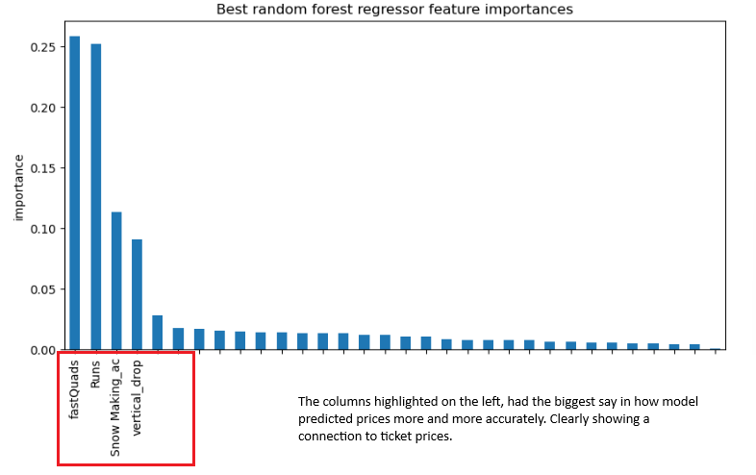
Modeling Results and Analysis
Our best-performing prediction model noted the following 4 factors as key components of ticket price:
Fast Quads
Runs
Snow Making Area
Vertical Drop
Big Mountain Resort Market delivers much higher than market standard for all four
Notes:
So, after exploring the key factors we enter the world of prediction, this might feel a bit daunting at first, but it is simpler than it looks.
One simple way to look at it is the further up and away our model is from the red line which denotes flipping a coin, the better the model is.
We see that both our models do a significantly better job than the red line, which is always a good thing. I don’t want to be replaced by a coin flip ☺
We can also see that the model in orange is further away from red line, this model identifies nearly 99% of customers who will accept or not accept the campaign.
Now these performances are for the data used to build the model, since we don’t have data from future, we used 85% of data to build this model and rest to test it!
That’s where the real challenge and the drop comes in, so exciting stuff ahead! Are we ready to find out how we did on the test?

Slide 6
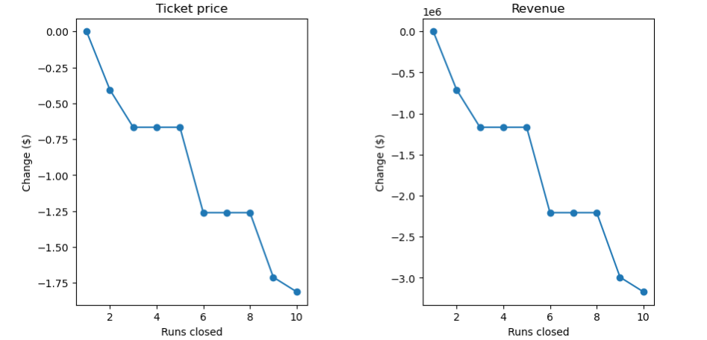
Modeling Results and Analysis
We looked at 4 business scenarios under consideration for investment
Scenario 4 had no impact on prices, while Scenario 1 analysis showed that closing one run had no impact but after that revenue dipped
Scenarios 2 and 3 showed an $8.61 and $9.90 increase in ticket prices respectively projecting higher revenue
Scenario1: Closing 1 run had no impact on ticket prices, after that there is a dip in projected revenue
Notes:
So, after exploring the key factors we enter the world of prediction, this might feel a bit daunting at first, but it is simpler than it looks.
One simple way to look at it is the further up and away our model is from the red line which denotes flipping a coin, the better the model is.
We see that both our models do a significantly better job than the red line, which is always a good thing. I don’t want to be replaced by a coin flip ☺
We can also see that the model in orange is further away from red line, this model identifies nearly 99% of customers who will accept or not accept the campaign.
Now these performances are for the data used to build the model, since we don’t have data from future, we used 85% of data to build this model and rest to test it!
That’s where the real challenge and the drop comes in, so exciting stuff ahead! Are we ready to find out how we did on the test?

Slide 7
Summary
Big Mountain Resort provides services aligned well with higher ticket prices
We have existing offerings to increase our ticket prices from $81 to $95.87 to support an 18% increase
Investment Scenarios 2 and 3 support an increase of $8.61 and $9.90 in ticket prices respectively
The following four offerings are big drivers in setting prices: Fast Quads, Runs, Snow Making Area, and Vertical Drop
Notes:
Here we can look at the summary of our target customer base, we mostly have customers who are not in a relationship and don’t have dependents accepting our campaigns. Customers with higher education and monthly spending are more likely to accept the campaign.
Finally, customers with recent purchases especially in last 20 days and those who have accepted campaigns in past are much more likely to accept marketing campaigns.

Slide 8


Thank You
Notes:
Thank you! For your patience and time, Please let me know if I can address any specific questions or provide further information. Thank you!

